Slide 1
Horizontal Motion Along A Straight Line

Slide 2
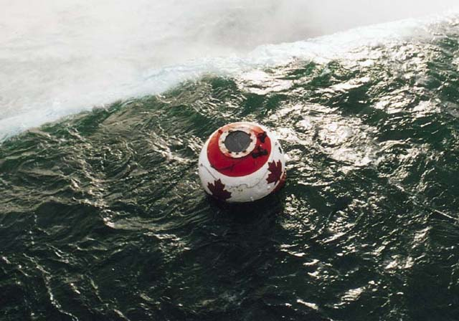
Motion
The world, and everything in it, moves.
Kinematics: describes motion.
Dynamics: deals with the causes of motion.

Slide 3
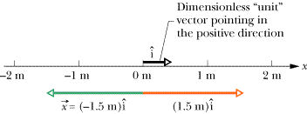
Scalar and Vector Quantities
Scalar quantities are completely described by magnitude only
Vector quantities need both magnitude (size or numerical value) and direction to completely describe them positive or negative to indicate directions

Slide 4
Distance and Displacement
Distance is a scalar quantity that measures how far an object has traveled during its motion
x is used as symbol for distance, x_{i} (initial distance) and x_{f} (final distance)
Displacement is a vector quantity that tells the position of the object from its starting point
X_{f} – X_{i} = displacement

Slide 5
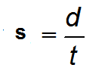
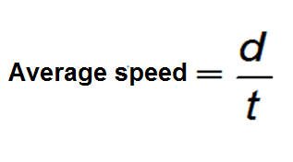
Speed vs Velocity
Speed is a scalar quantity and it is measured by:
Where:
s – speed
d – distance
t -time

Slide 6
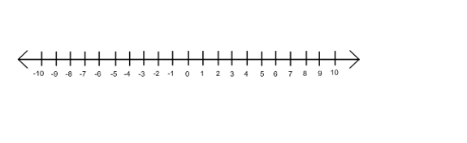


What is the dog’s average speed?
t = 5 s
t = 8 s
t = 10 s
t = 0 s

Slide 7
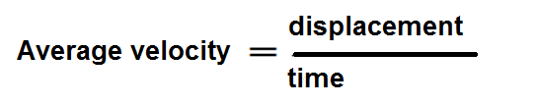
Velocity
is a vector product (with magnitude and direction)
=
6m
s
,West

Slide 8
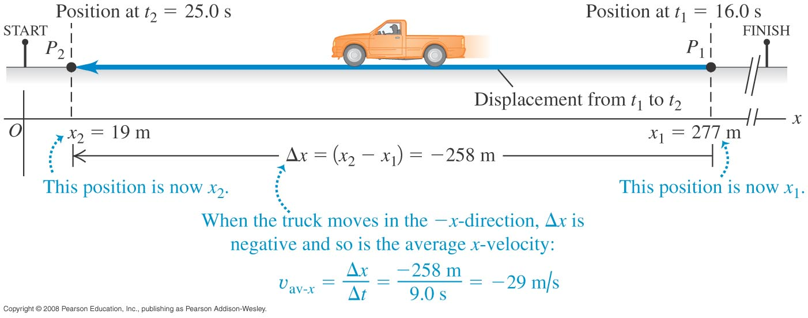
Negative velocity
The average x-velocity is negative during a time interval if the particle moves in the negative x-direction for that time interval.

Slide 9
Uniformly Accelerated Motion
When an object’s velocity changes constantly either in magnitude or direction, the object is in accelerated motion. When a moving object speeds up, the acceleration is positive and when the object slows down, the acceleration is negative

Slide 10
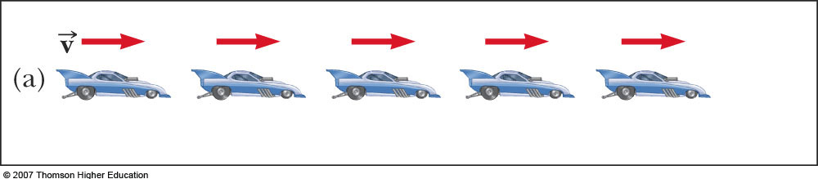
Acceleration and Velocity
Images are equally spaced. The car is moving with constant positive velocity (shown by red arrows maintaining the same size)
Acceleration equals zero

Slide 11
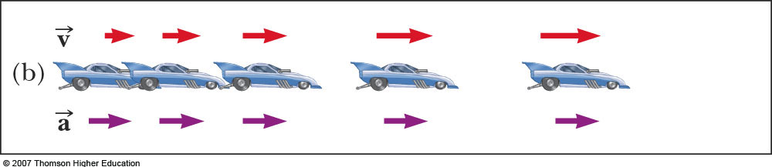
Acceleration and Velocity
Images become farther apart as time increases
Velocity and acceleration are in the same direction
Acceleration is uniform (violet arrows maintain the same length)
Velocity is increasing (red arrows are getting longer)
This shows positive acceleration and positive velocity

Slide 12
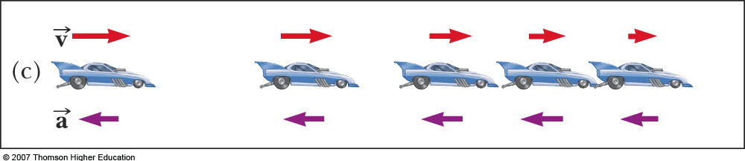
Acceleration and Velocity
Images become closer together as time increases
Acceleration and velocity are in opposite directions
Acceleration is uniform (violet arrows maintain the same length)
Velocity is decreasing (red arrows are getting shorter)
Positive velocity and negative acceleration

Slide 13
Acceleration
Where:
V_{f} – final velocity
V_{i} – initial velocity
Δt – change in time
a = v_{f} – v_{i}
Δt

Slide 14
Average Acceleration
Acceleration is the rate of change of the velocity

Slide 15
Kinematic Equations, specific
For constant a,
Can determine an object’s velocity at any time t when we know its initial velocity and its acceleration
Assumes t_{i} = 0 and t_{f} = t
Does not give any information about displacement

Slide 16
Kinematic Equations, specific
For constant acceleration,
The average velocity can be expressed as the arithmetic mean of the initial and final velocities

Slide 17
Kinematic Equations, specific
For constant acceleration,
This gives you the position of the particle in terms of time and velocities
Doesn’t give you the acceleration

Slide 18
Kinematic Equations, specific
For constant acceleration,
Gives final position in terms of velocity and acceleration
Doesn’t tell you about final velocity

Slide 19
Kinematic Equations, specific
For constant a,
Gives final velocity in terms of acceleration and displacement
Does not give any information about the time

Slide 20
When a = 0
When the acceleration is zero,
v_{xf} = v_{xi} = v_{x}
x_{f} = x_{i} + v_{x} t
The constant acceleration model reduces to the constant velocity model

Slide 21
Examples
A sprinter starting from rest speeds up and covers a distance of 100 meters in 15 seconds. Assuming constant acceleration, compute the sprinter’s
acceleration during 100-m sprint
velocity when he reaches the 100-m mark
distance from the starting point after 8 seconds

Slide 22
Assignment
A cyclist moving at 12 m/s starts to slow down when he sees danger along his path. He stops after exactly 4 seconds. What is the distance covered by the cyclist when he stops?

Slide 23
Assignment 3
A bike accelerates uniformly from rest to a speed of 8.00m/s over a distance of 40.0 m. Determine the acceleration of the bike.

Slide 24
Objects in Free Fall Motion

Slide 25
Falling Objects
When an object is dropped from a certain height, its initial velocity is zero. But there are cases wherein an object is thrown downward. In these cases, the object’s initial velocity is not equal to zero. Since the object’s direction is downward, consider velocities and displacement to be negative.

Slide 26
Kinematics equation for uniformly accelerated motion
V_{f} = V_{i} - |g|t
y = V_{i}t – ½ |g|t²
V_{f}2 = V_{i} – 2|g|y

Slide 27
Example 1
A stone is dropped from the top of a 400-m high building
How long will it take for the stone to reach the ground?
What is the stone’s velocity when it reaches the ground?

Slide 28
Objects Thrown Upward
When an object is thrown upward, its initial velocity decreases by 9.8m/s until it becomes zero reaching its maximum height. The decrease is because of the acceleration due to gravity. When an object’s velocity is already zero, the object will start to fall. The time that the object reaches the maximum height is the same as the time that the object goes back to its original position.

Slide 29
Example 2
A ball is thrown upward with an initial velocity of 10.00 m/s
How high does the ball rise?
What is its total time of flight?

Slide 30
Assignment 4
A calculator falls off the side of the teacher’s table and hits the floor of 0.40 s later.
How high is the table?
How fast is the calculator traveling when it hits the floor?

Slide 31
Seatwork 2
A guava thrown straight upward rises to 18.00m above its launch point. At what height has the guava speed increased to one-half of its initial value?
How fast must a coin be thrown upward to reach a height of 15.00 m?

